Slide 1
Welcome
Library Management System

Slide 2
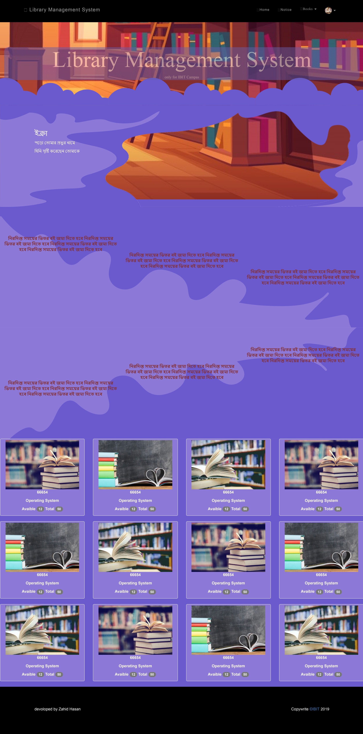

Slide 3
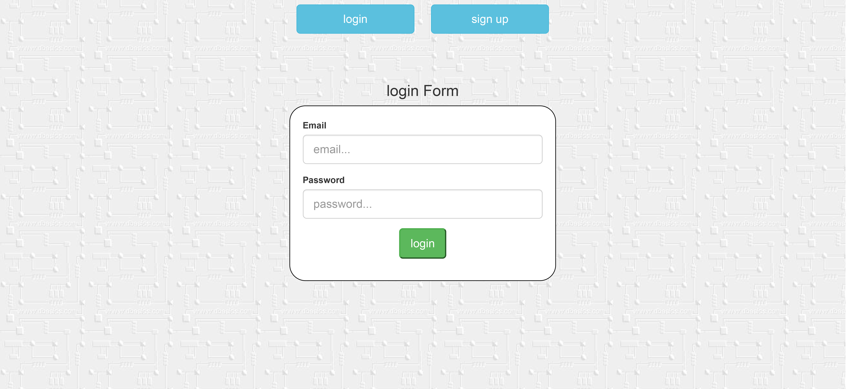

Slide 4
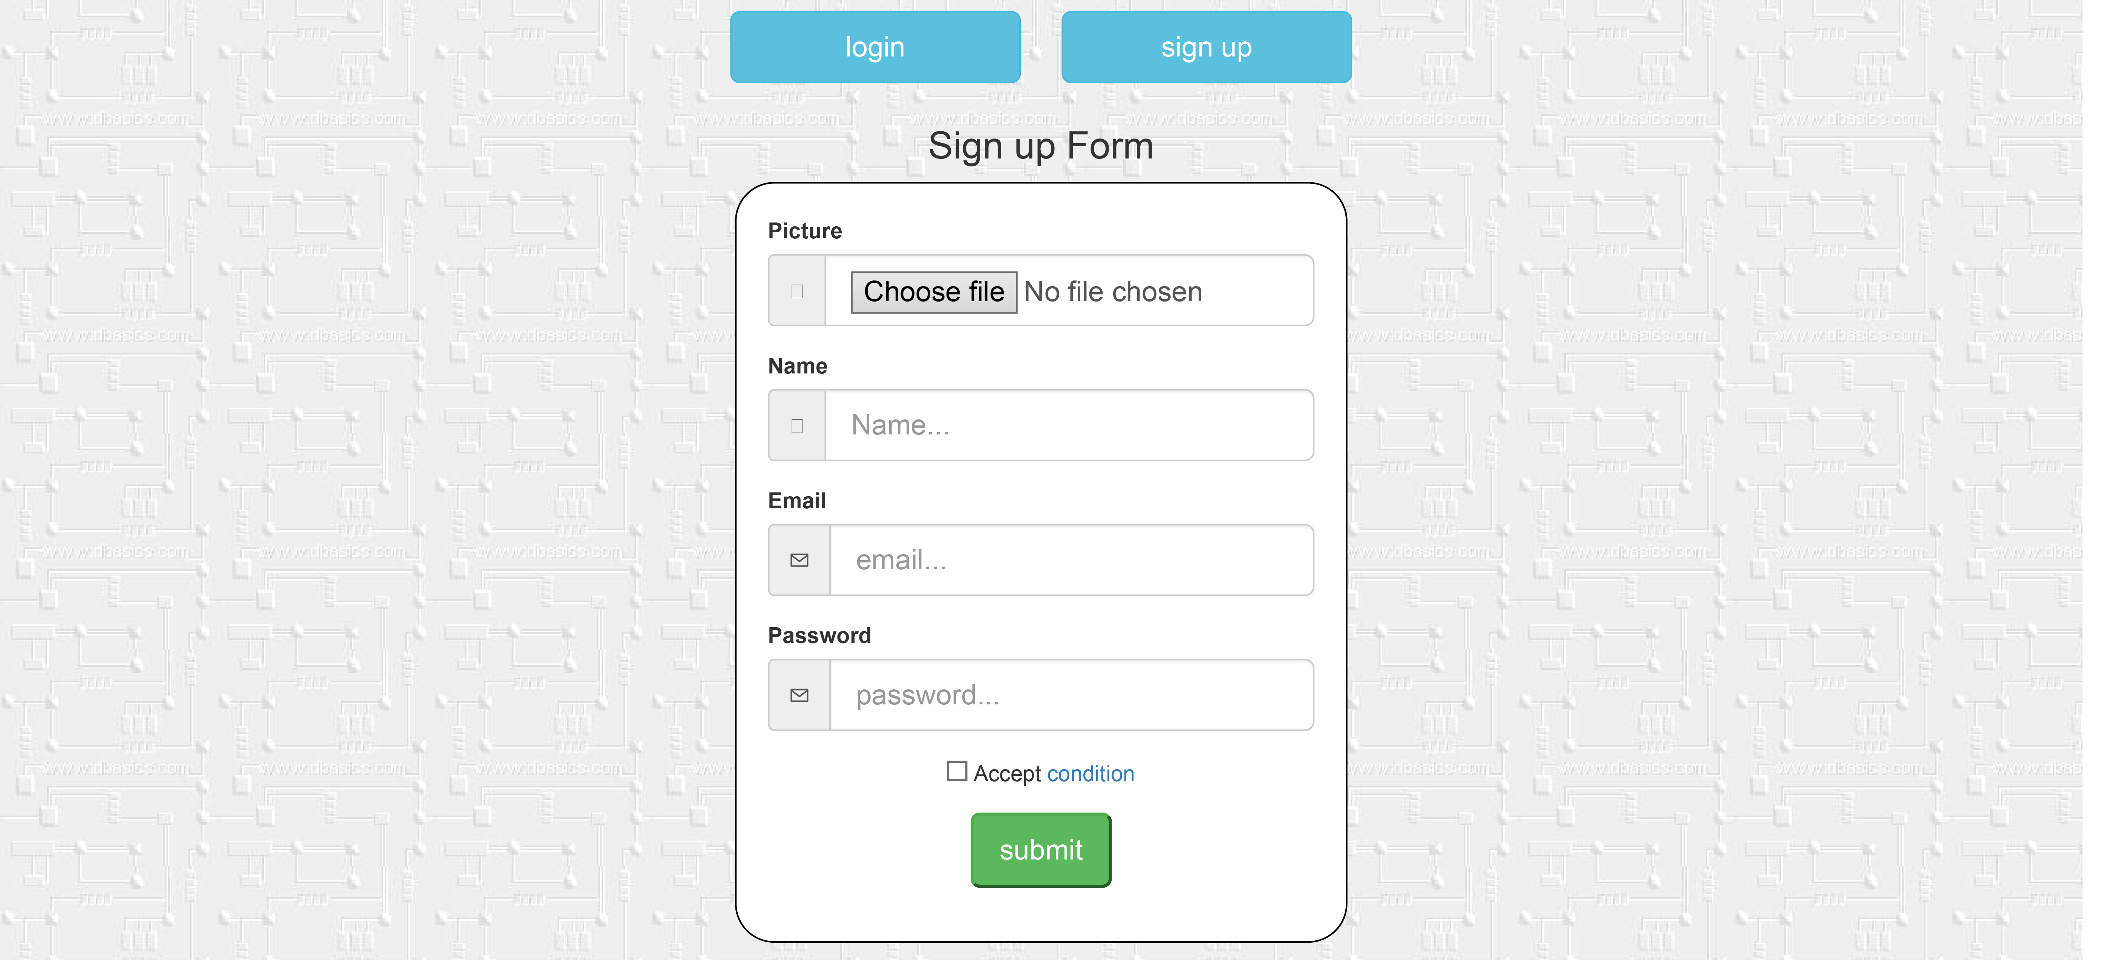

Slide 5
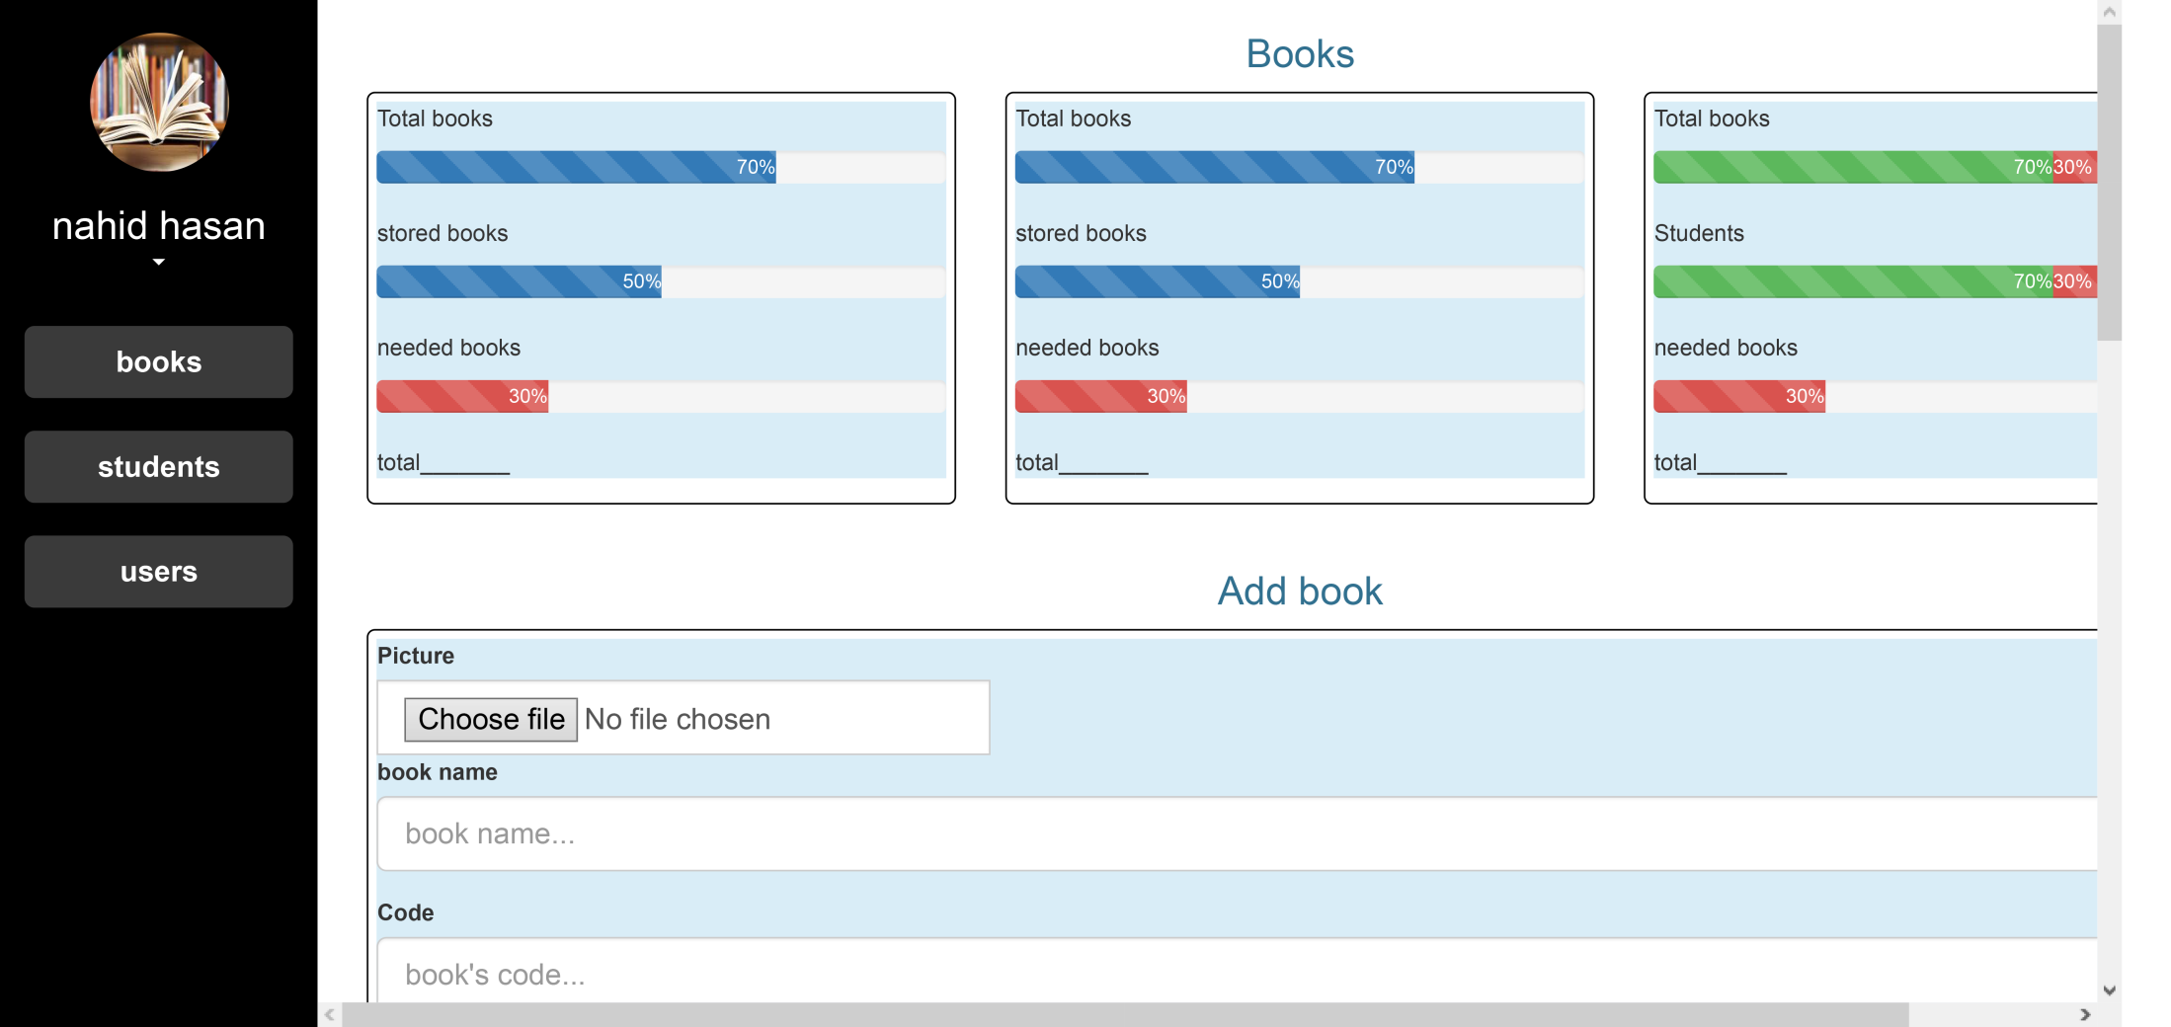

Slide 6
Home Page

Slide 7



Slide 8
Dashboard

Slide 9

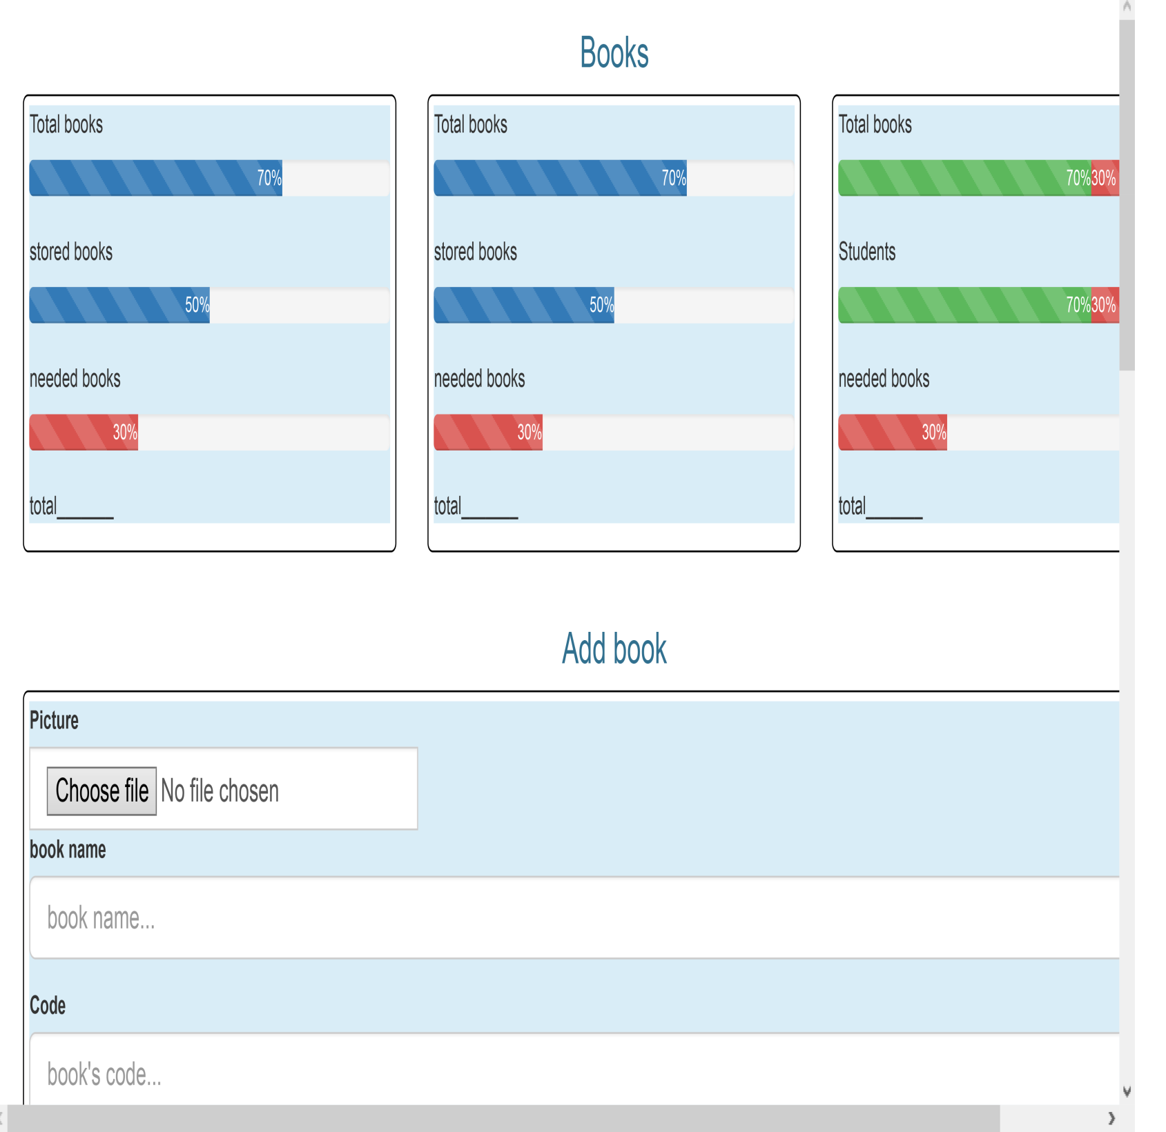

Slide 10
The End

